Slide 1
Egress Elements
Explain how the Fire Safety Concept Tree applies to the course
Explain the purpose of the means of egress
Distinguish between the three elements of the means of egress

Slide 2
Historic Fire
Happy Land Social Club

Slide 3
Fire Safety Concepts Tree
Fire Safety Objectives
NFPA 550
Prevent Fire Ignition
Manage Fire Impact
Manage Fire
Manage Exposed

Slide 4
Fire Safety Concepts Tree
Manage Exposed
Limit Amount Exposed
Safeguard Exposed
Move Exposed
Defend Exposed in Place
Cause Movement of Exposed
Provide Movement Means
Provide Safe Destination

Slide 5

Codes
Minimum requirements
Can exceed
Not a limit on what can be done
Based on consensus
Best practices

Slide 6
Egress Elements
Exit
Meaning
Examples

Slide 7
Egress Elements
Exit Access
The portion of a means of egress that leads to an exit.
Exit
The portion of a means of egress that is separated from all other spaces of the building or structure by construction, location, or equipment as required to provide a protected way of travel to the exit discharge.
Exit Discharge
The portion of a means of egress between the termination of an exit and a public way.

Slide 8
Egress Elements
Public Way
A street, alley, or other similar parcel of land essentially open to the outside air deeded, dedicated, or otherwise permanently appropriated to the public for public use and having a clear width and height of not less than 10 ft.
The code intends a situation where occupants egressing from a building ultimately reach a point where they can move away from the building unimpeded and no longer need the protection of the Code.

Slide 9
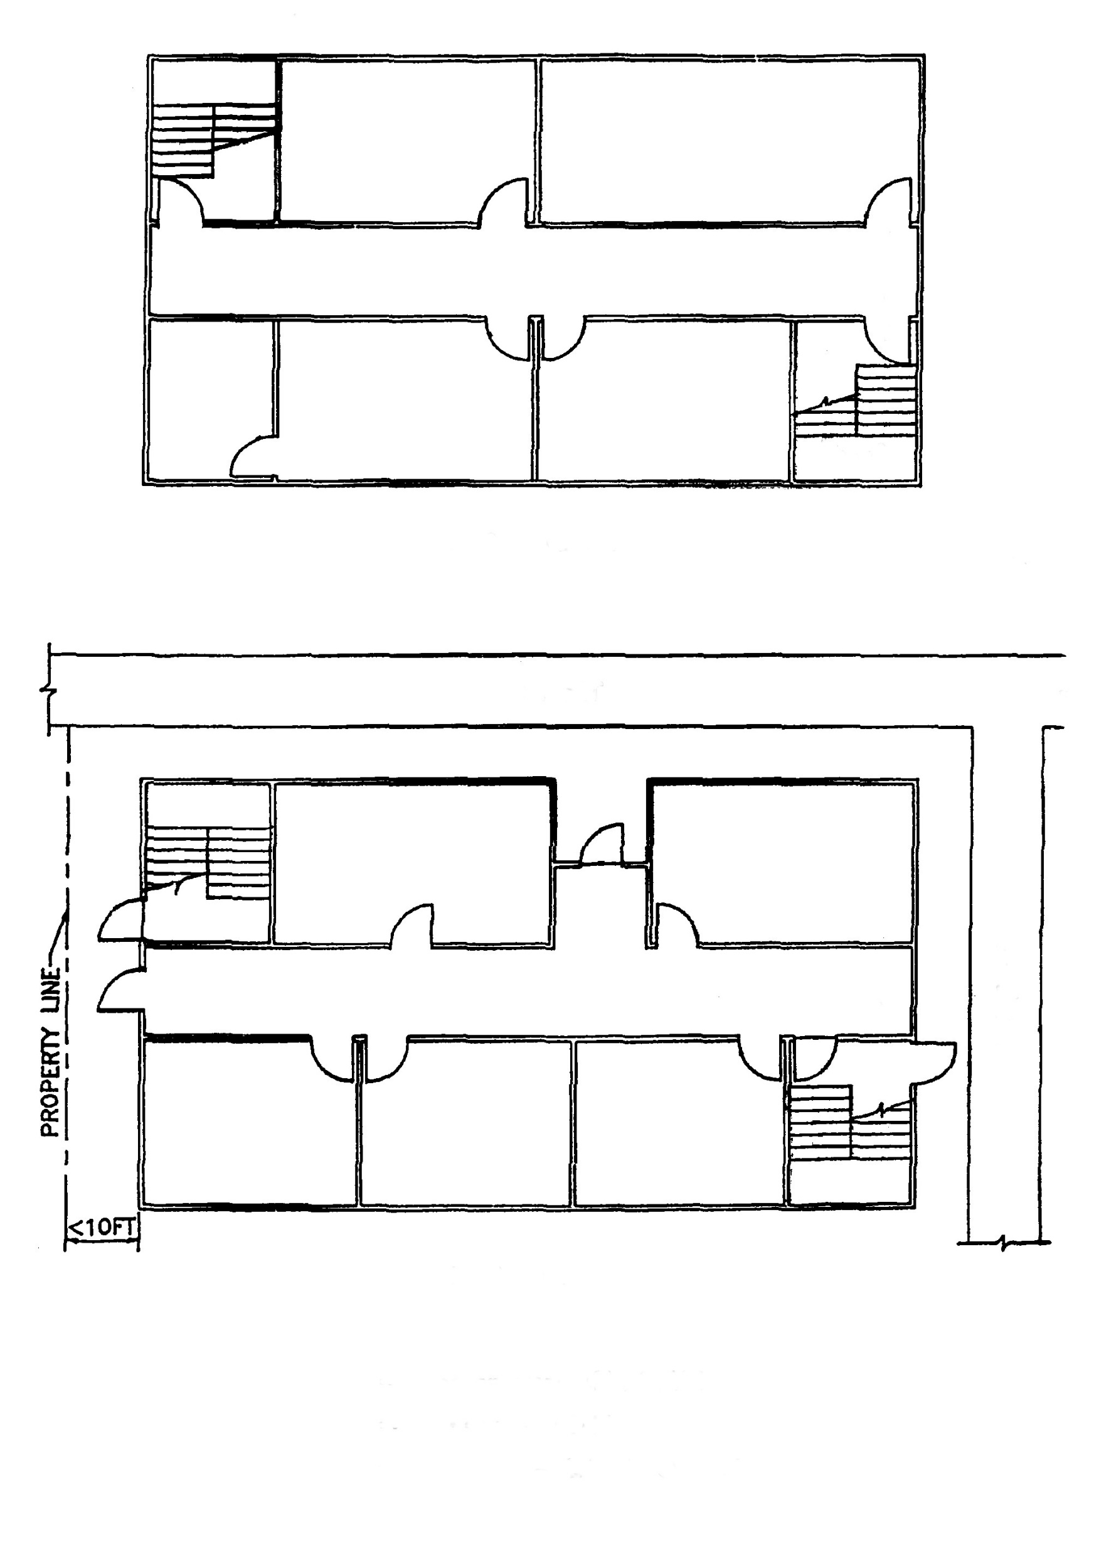
Egress Elements
EXIT ACCESS
STREET
EXIT DISCHARGE
S
T
R
E
E
T
EXIT
GROUND FLOOR

Slide 10
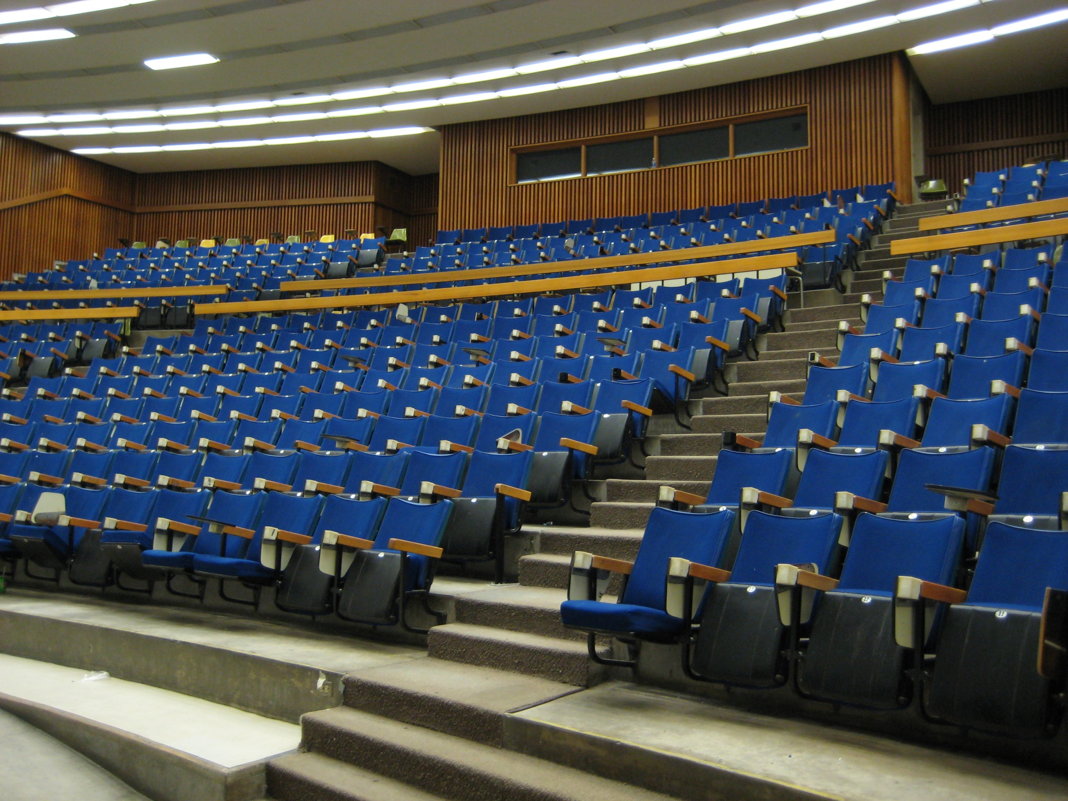

Slide 11
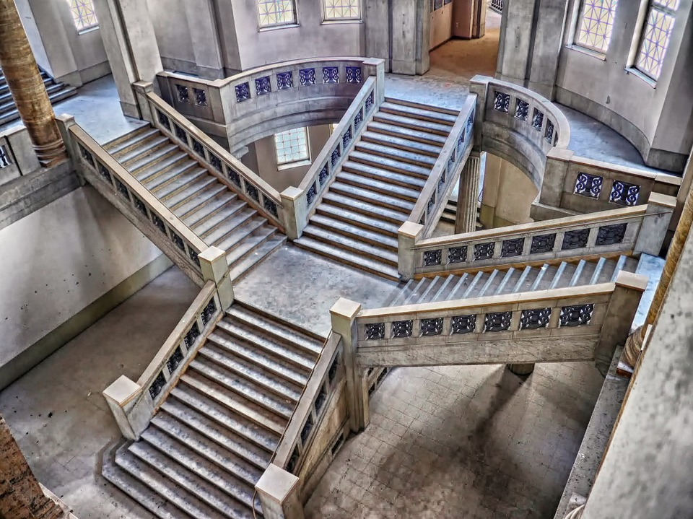

Slide 12
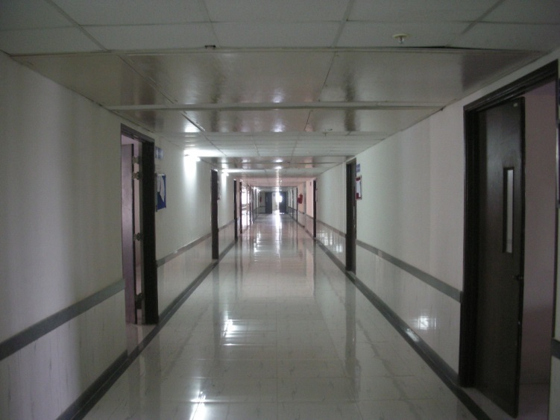

Slide 13
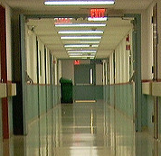

Slide 14
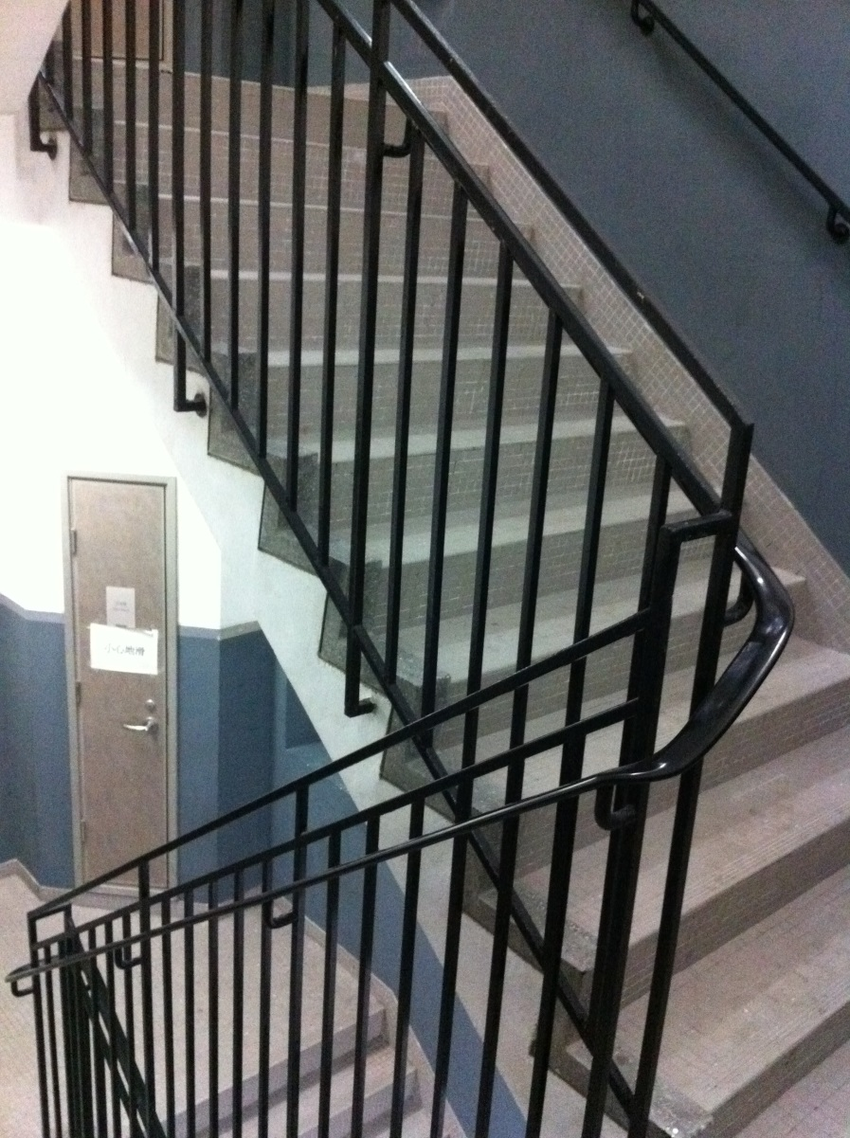

Slide 15
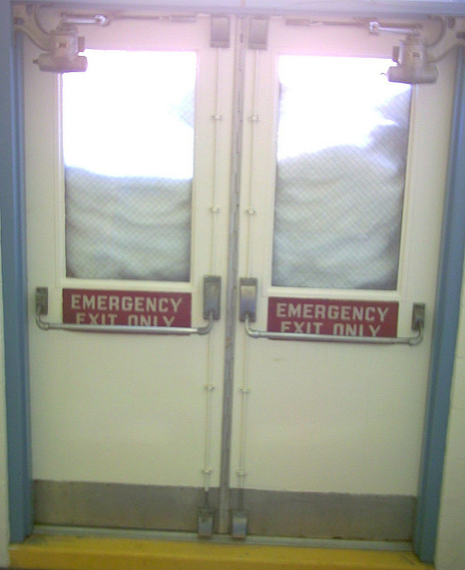

Slide 16
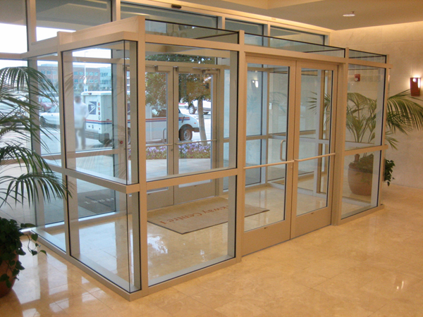

Slide 17
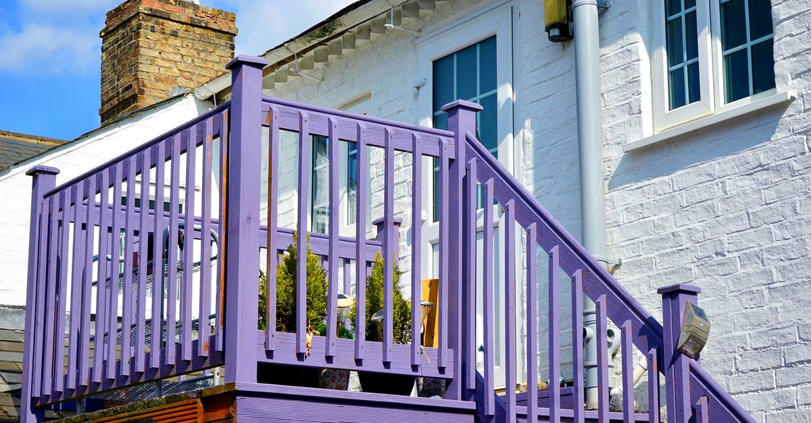

Slide 18
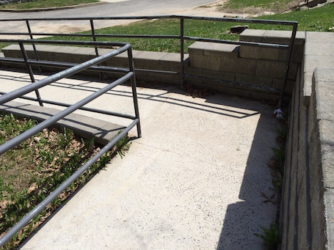

Slide 19
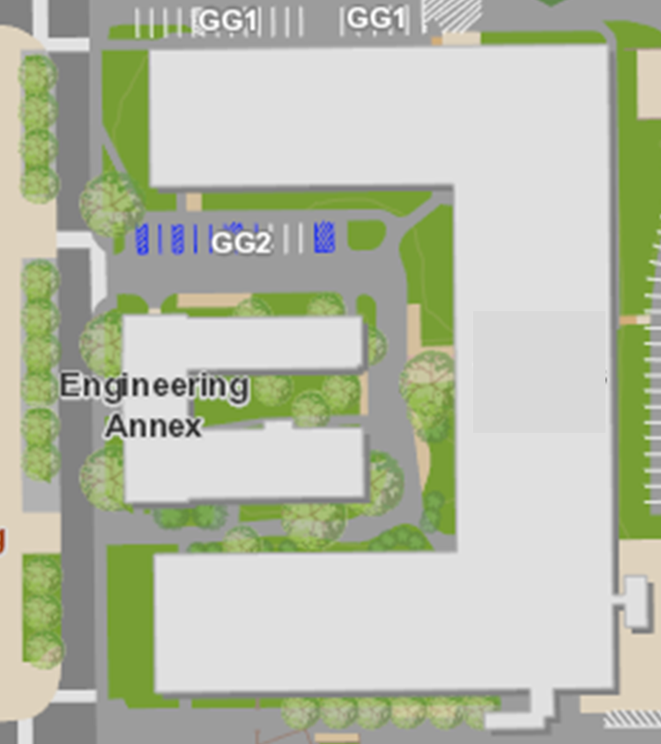

Slide 20
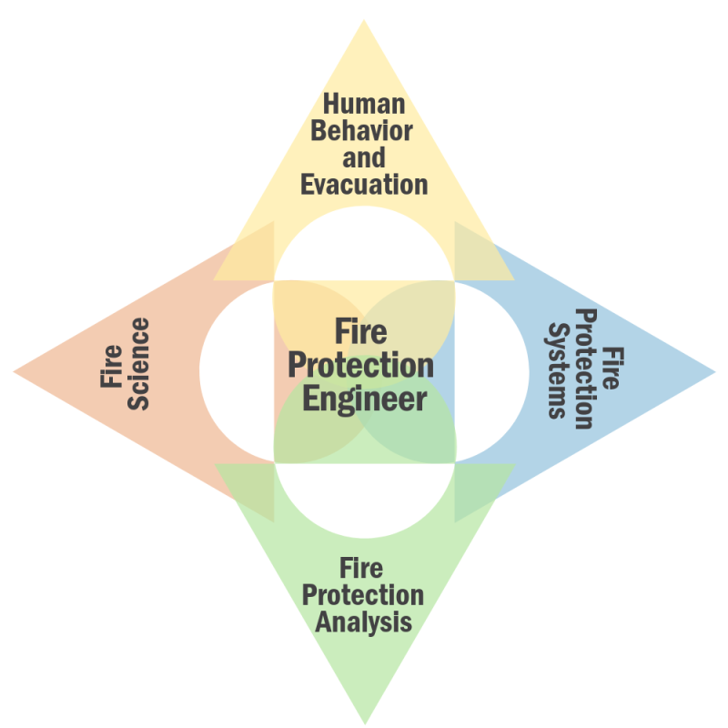
Professional Requirements
PE Exam
85 total questions
11-17 questions on egress and occupant movement
https://ncees.org/wp-content/uploads/PE-Fire-Oct-2020_CBT_with-standards.pdf
CSP Exam
Part of Domain 4
SFPE core competencies

Slide 21
Intent
Identify hazards
No building is 100 % compliant
Understand impact of deficiency
Different than identifying code requirements

Slide 22
Means of Egress
Identify minimum required widths
Determine the clear width
Explain the rules for the means of egress

Slide 23
Historic Fire
Cocoanut Grove

Slide 24
Means of Egress
Chapter 7 of NFPA101
Chapter 10 of IBC
Fundamental to life safety

Slide 25
Means of Egress Requirements
Level
Not more than ¼ in
More than ½ in change in level
Clearance
7 ft 6 in
6 ft 8 in
Slip resistant
No obstructions

Slide 26
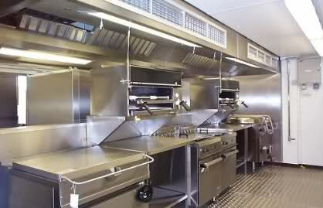
Decreasing Hazard
From corridor to a room
From one room to another room
Through kitchens
Through mechanical rooms
Rated enclosure to unprotected space
Enclosed stair to lobby
Stairs directly to outside

Slide 27
Minimums
Doors and Corridors
Stairs
Access: 36 in
Doors:
Clear width
28 in
32 in
Cannot decrease in direction of travel
44 in
Exception 36 in
56 in
Cannot decrease in direction of travel

Slide 28
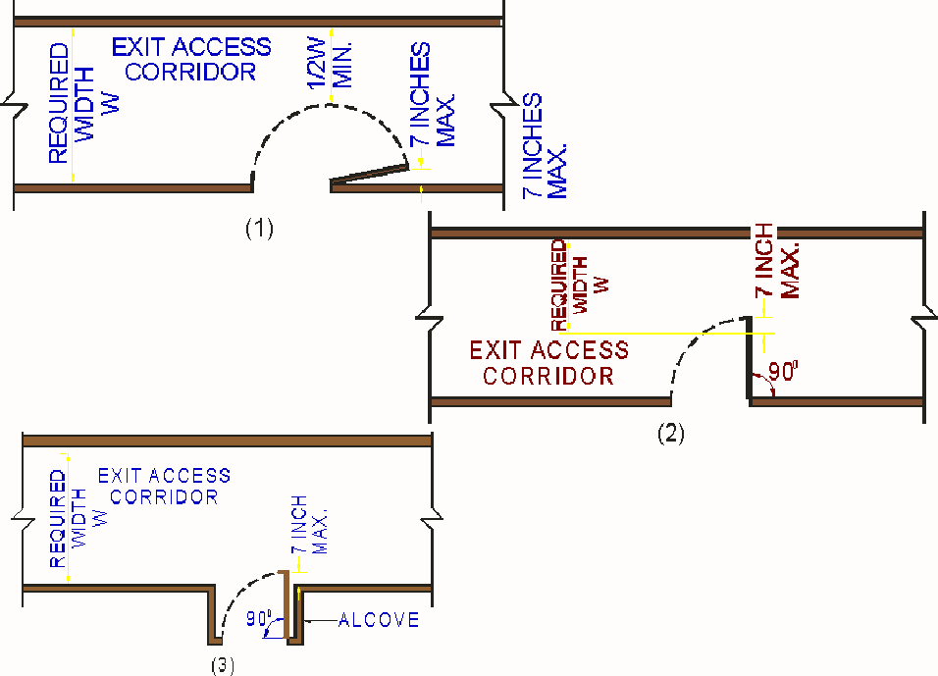
Clear Width
Doors
Stairs
Corridors

Slide 29
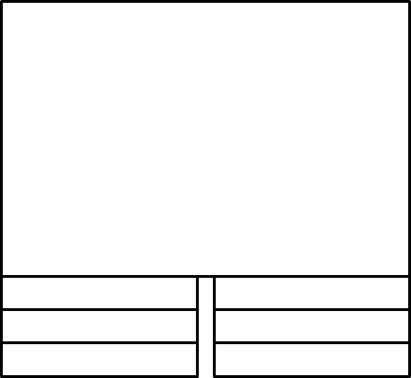
Landings
No decrease in width
Length equal to width of stairs
48 in
At doors

Slide 30
Exits
Calculate the number of exits required
Explain how the exit should not be used

Slide 31
Historic Fire
Rhythm Nightclub

Slide 32
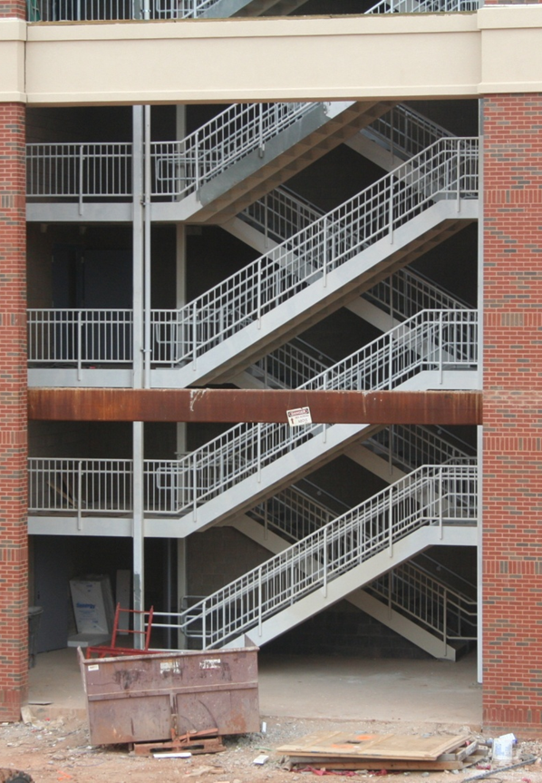
Number of Exits
Based on the number of people
Not dependent on type of occupancy
Assume single exit could be blocked
50 %

Slide 33
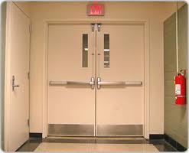
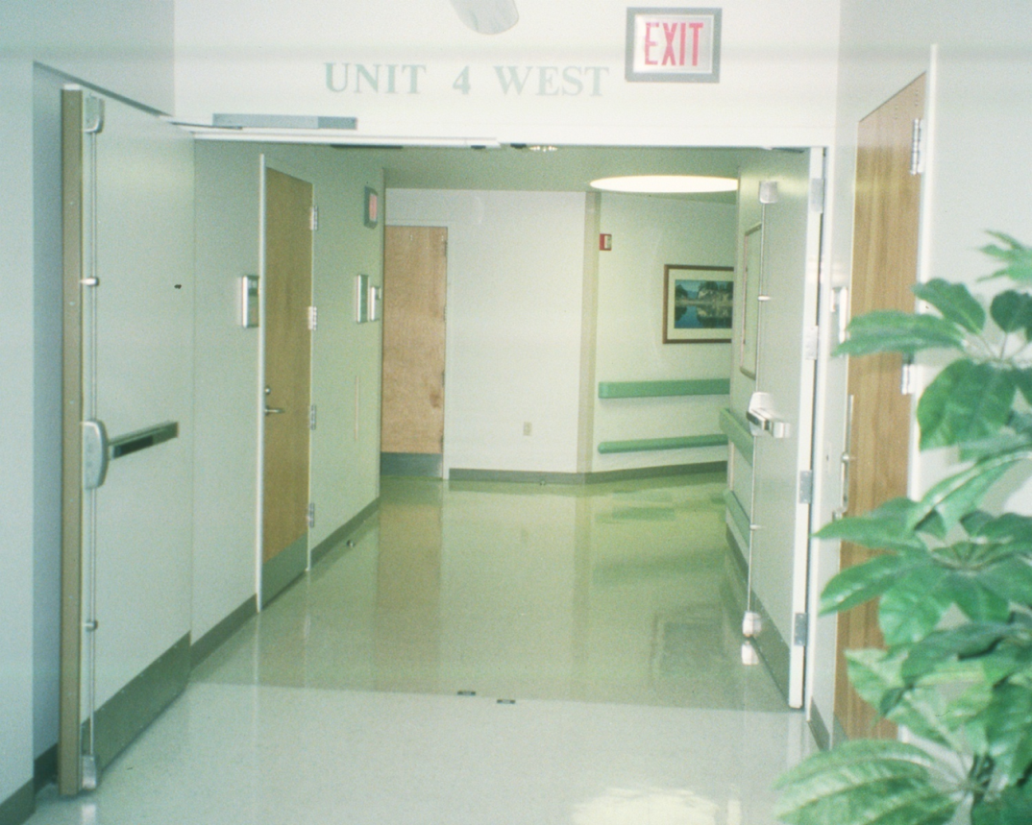
Horizontal Exit

Slide 34
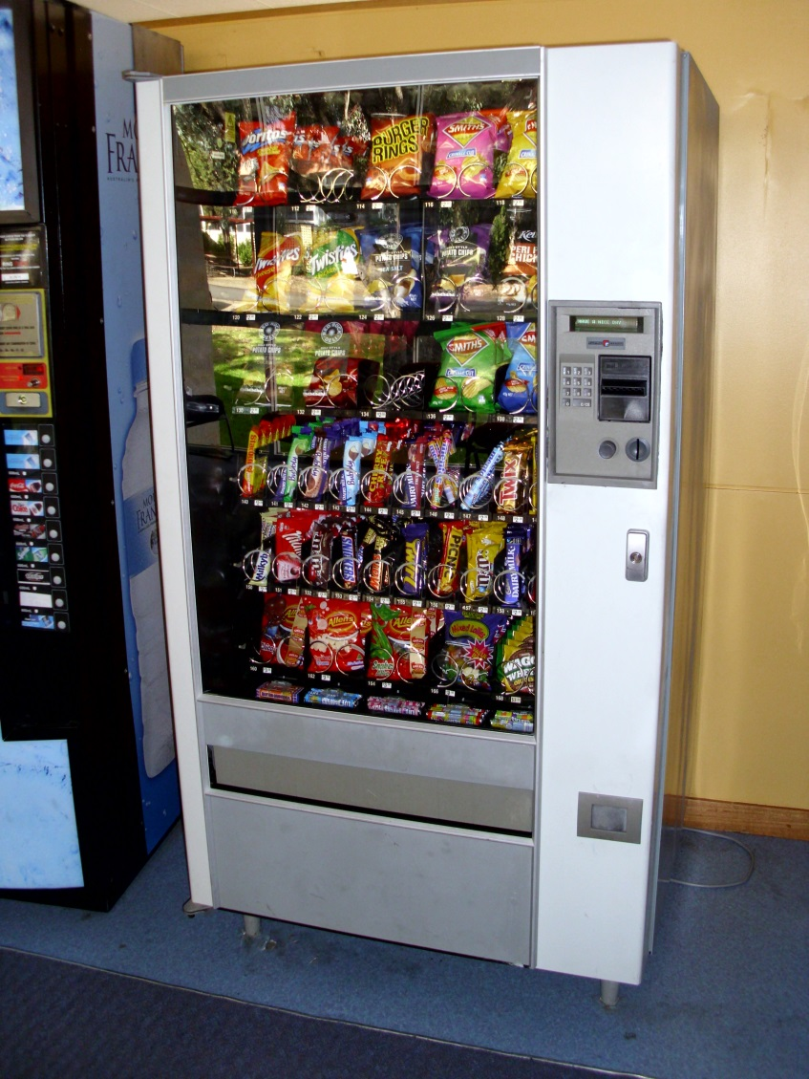
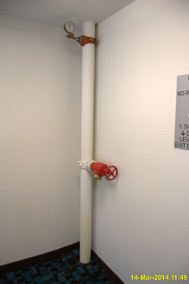
Exit Usage
Fire protection systems only

Slide 35
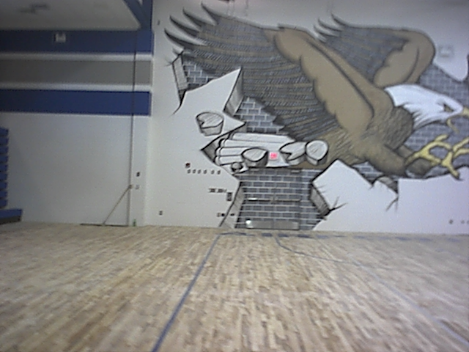
Unit 7 35

Slide 36
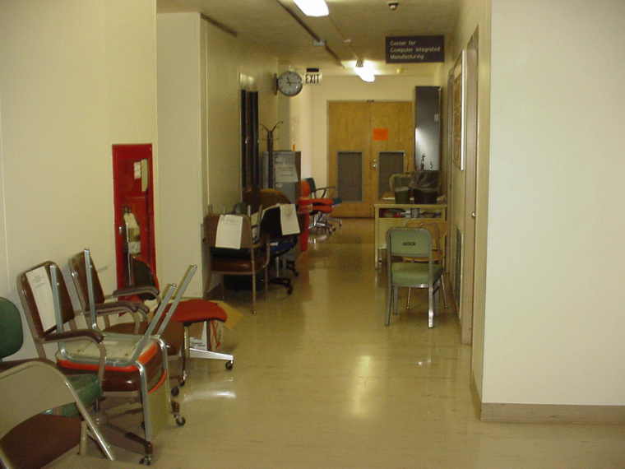
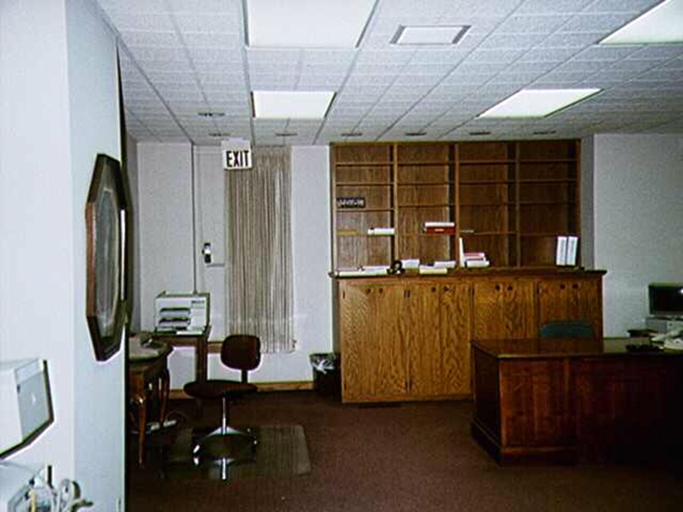
Maintenance of Exits

Slide 37
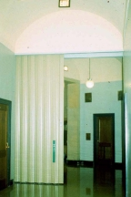
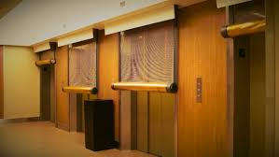
Enclosures

Slide 38
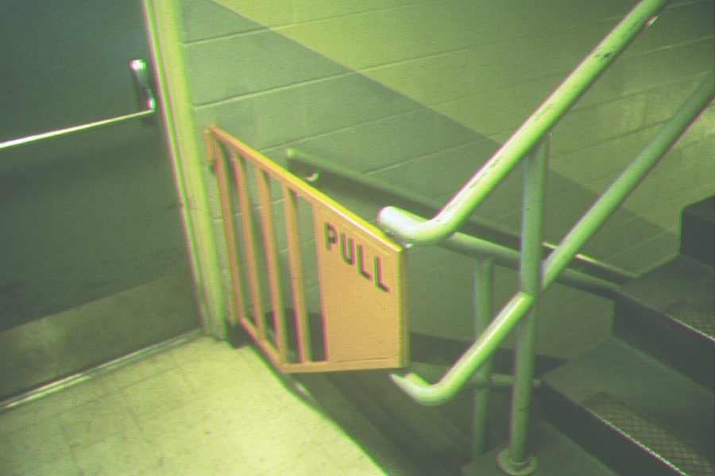

Slide 39
Doors and Corridors
Calculate the minimum size of doors and corridors
Identify the features of doors and corridors

Slide 40
Historic Fire
Hartford Hospital

Slide 41
Minimum Widths
NFPA rules
IBC rules

Slide 42
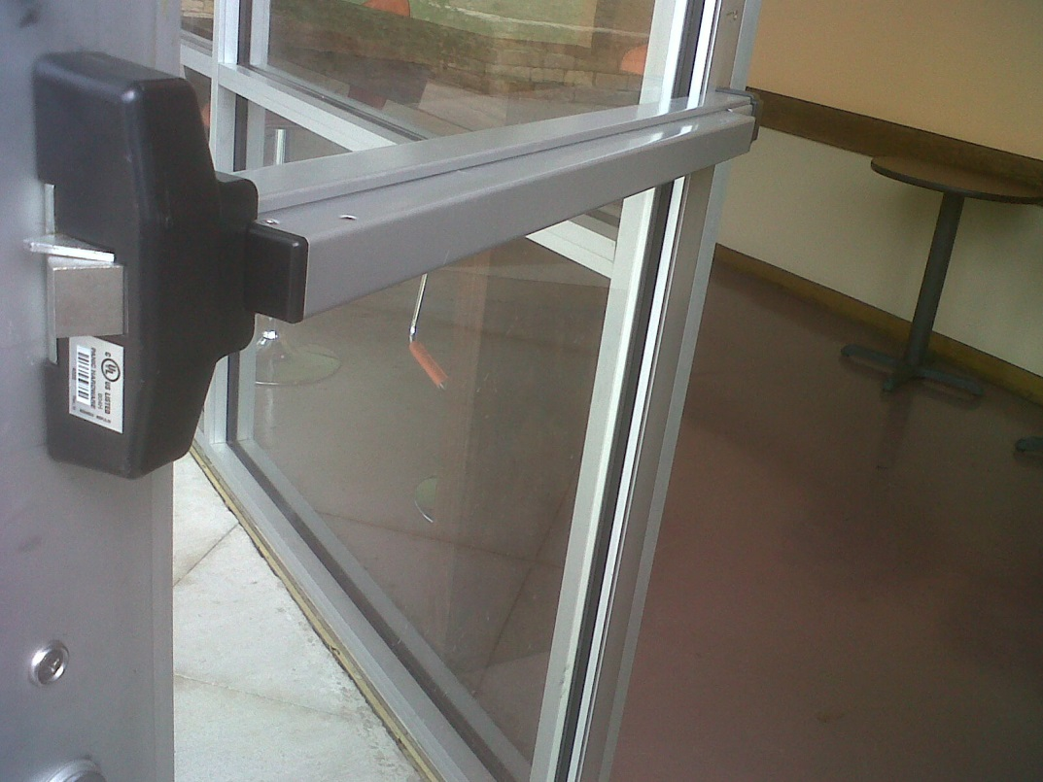
Doors
Direction
Hardware
Locks
Delays
Forces
Labels

Slide 43
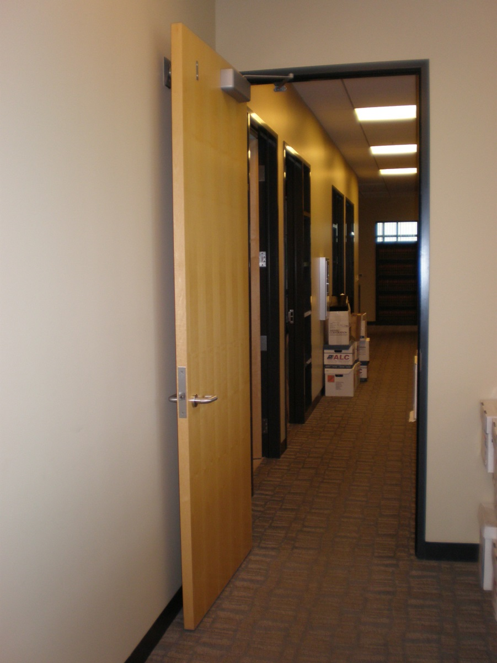
Doors
Automatic-closing
Self-closing
Level
Width of leaf on either side
Egress side
Ingress side

Slide 44
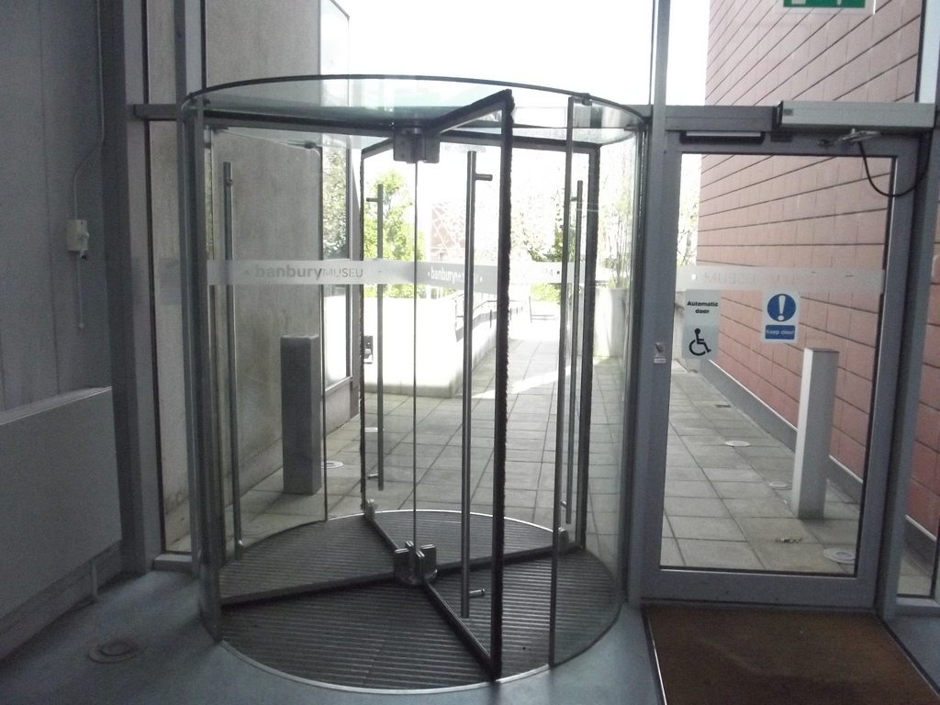
Revolving Doors
Typically not include in means of egress
Must have regular doors adjacent
Doors must break-away in direction of travel
Rules on speeds

Slide 45
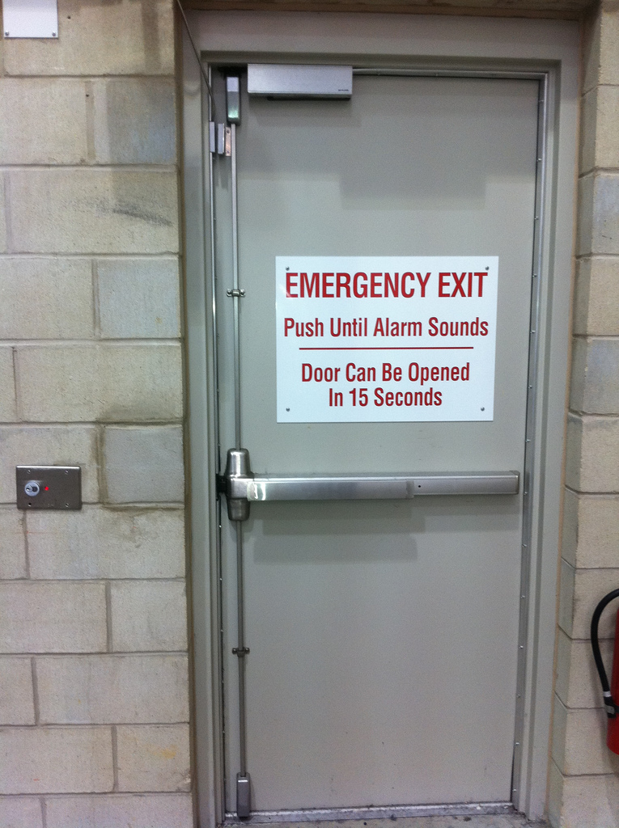
Doors
Single action
No special knowledge
No special tools
Lock side based on security

Slide 46
Other Components
Identify other elements that can be part of the means of egress
Determine when other components are appropriate to use

Slide 47
Historic Fire
Cook County Administration Building

Slide 48
Others
Areas of Refuge
Area to wait
Separated
Connected to means of egress
48 in stair
2 way communication
Accessible
Size
A 30 in x 48 in wheelchair space per 200 occupants
Smoke Proof Enclosure
Outside building
Protected shaft

Slide 49
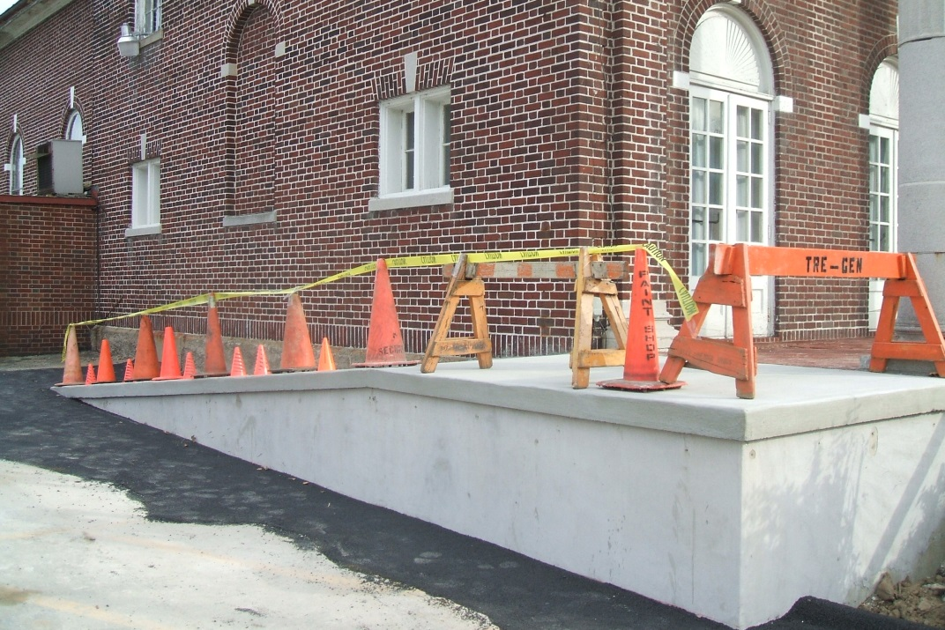
Others
≥ 44 (30) in clear width
≤ 1 in 12 (8) slope
≤ 30 in (12 ft) rise per run
Landings
Top and bottom
Length ≥ 60 in if accessible, ≥ 48 in otherwise
Other provisions similar to stairs

Slide 50
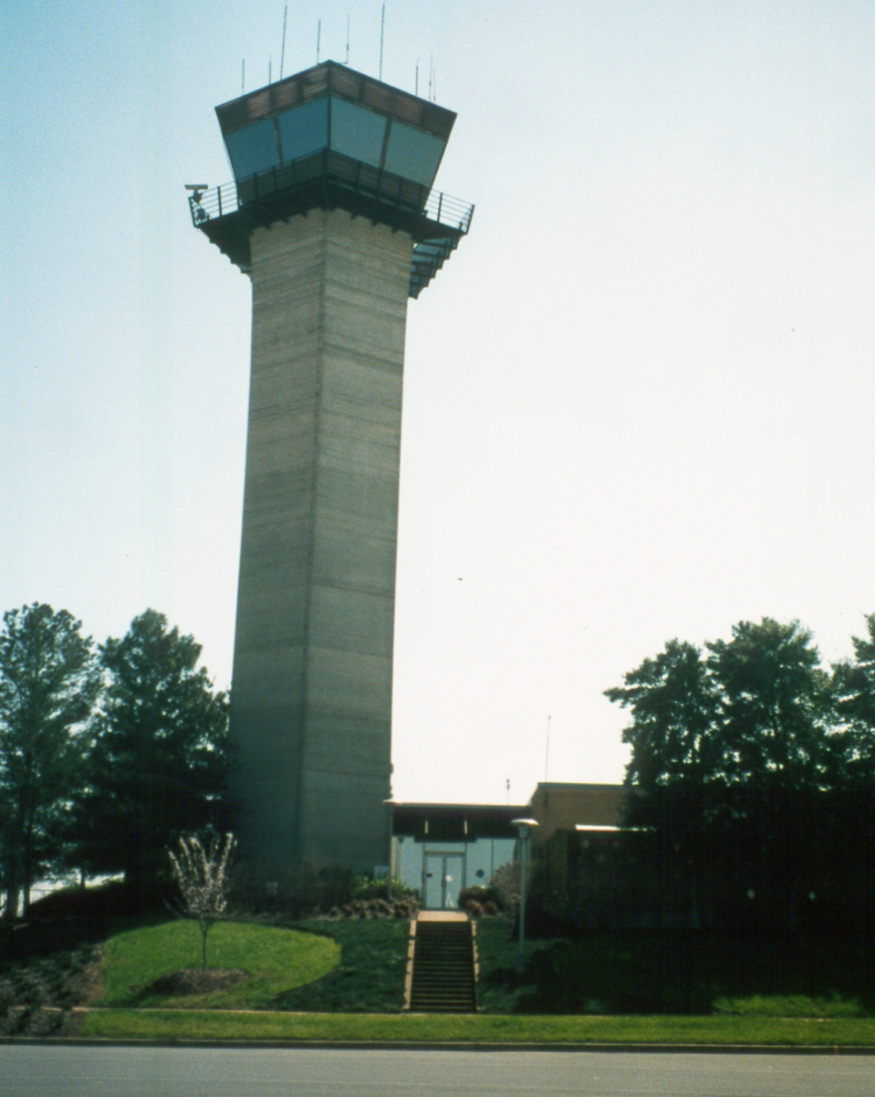
Others
Second means of egress
≤ 90 persons
100 % capacity independent
Training
No general public
≥ 8 persons capacity
Lobby
A 30 in x 48 in wheelchair space per 50 occupants
3 ft² for ≥ 50 % occupant load
Separated and two-way communication

Slide 51

Others
Before Phase I
Stair replacement?
Shaft with stair
Signage
FFCP
2 way communication
Building must have
Voice alarm
Sprinklers

Slide 52
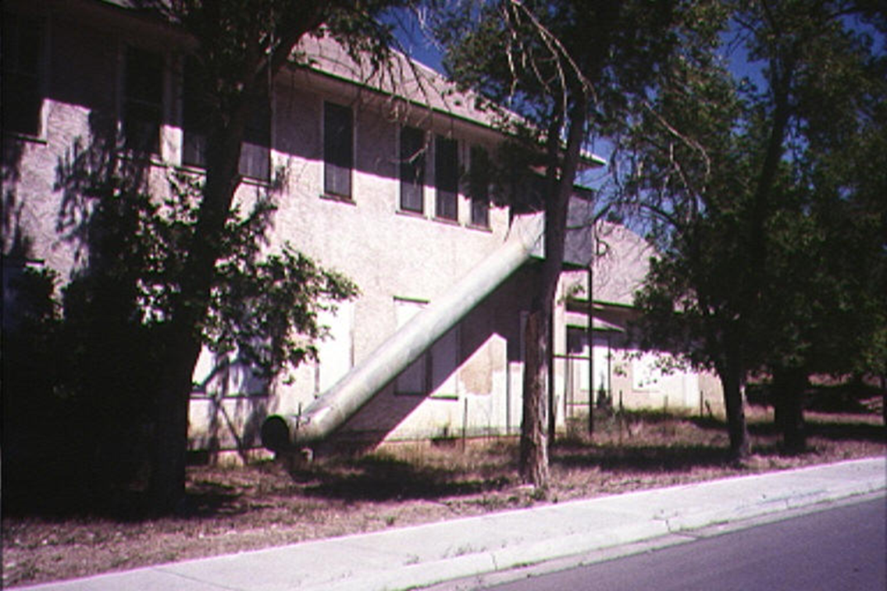
Others
60 persons capacity
≤ 25 % of capacity except in industrial
Must be allowed by occupancy chapter
Not allowed for most
Training required

Slide 53
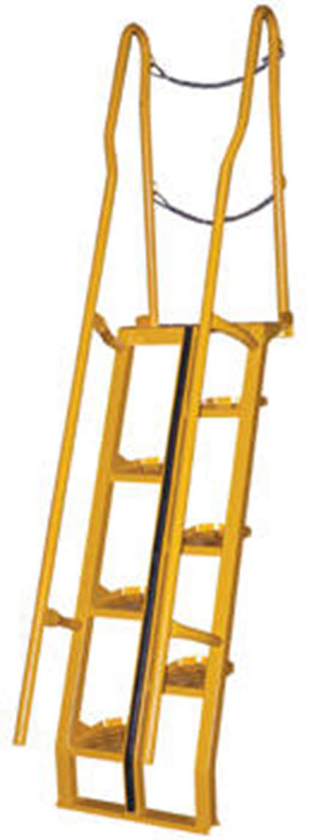
Others
Allowed in spaces with occupant loads < 4
Unoccupied roofs
Second option from storage elevators and boiler rooms
Towers and elevated platforms around machinery
Dimensions
17 in ≤ Clear width ≤ 24 in
6 ft 8 in headroom
50 ° ≤ Clear width ≤ 68 °
Riser height ≤ 9.5 in
Tread depth ≥ 9.5 in
≥ 5.67 in not overlapped
Lateral separation ≤ 2 in

Slide 54
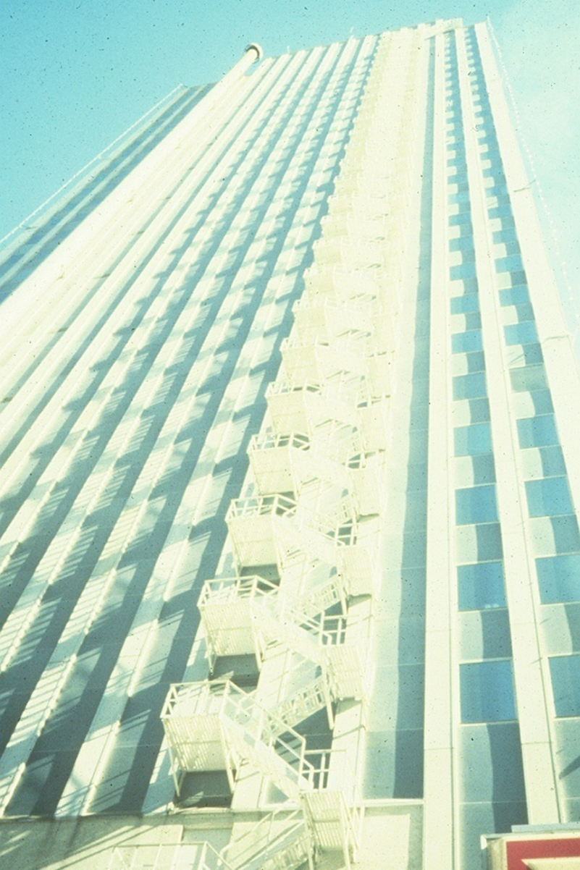
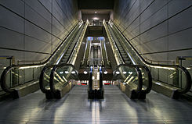
Others

Slide 55
Ladders
Access to unoccupied spaces
Second means of egress from storage elevators or boiler rooms with occupant loads < 4 persons
Towers and elevated platforms around machinery with occupant loads < 4 persons
> 75°
Lowest rung ≤ 12 in of surface

Slide 56
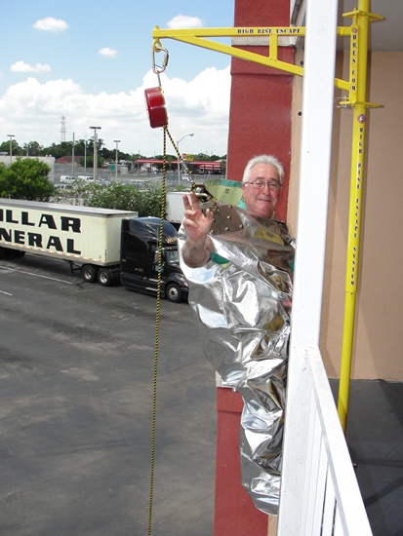
Supplementary Escape Devices

Slide 57
Stairs
Calculate the minimum size of stairs
Identify the features of stairs

Slide 58
Historic Fire
Grenfell Tower

Slide 59
Stairs are Simple
https://themindcircle.com/30-epic-stair-design-fails/

Slide 60
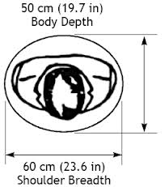
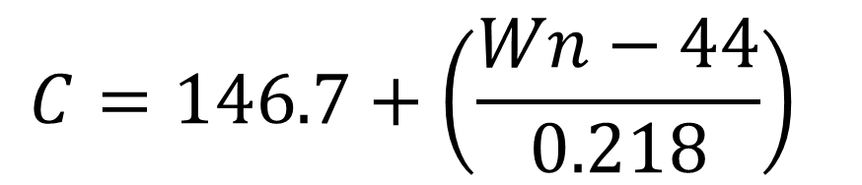
Stair Widths
Exit lanes
Not used by NFPA101 or IBC
Width calculations
NFPA
IBC

Slide 61
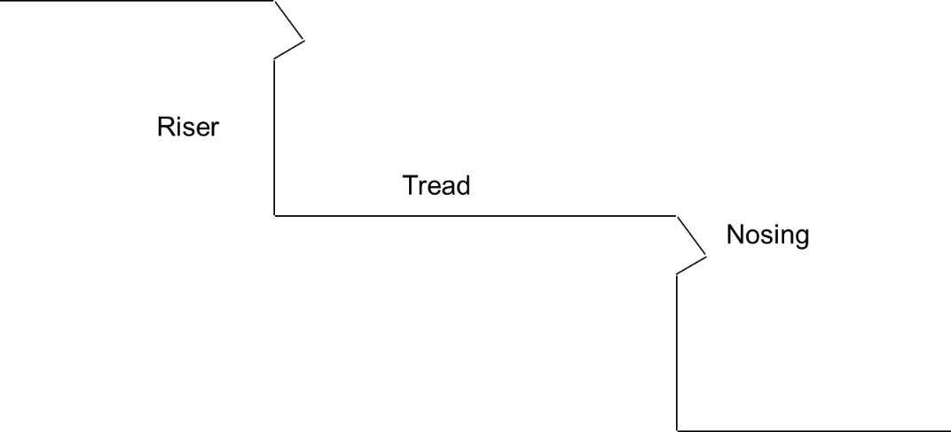
Stairs
Size
Usage
Slip resistant
Marked
Changes in size
3/16 in
3/8 in

Slide 62
Stair Terminology
Flight
Landing
Dog-leg
Sinistral
Dextral
Straight
Curved
Spiral

Slide 63

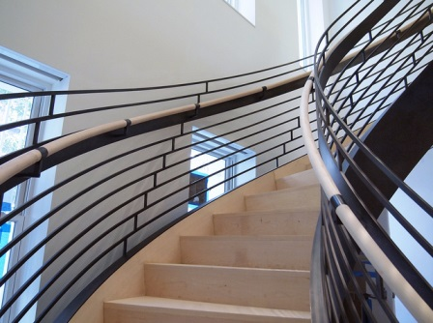
Curved and Spiral Stairs

Slide 64
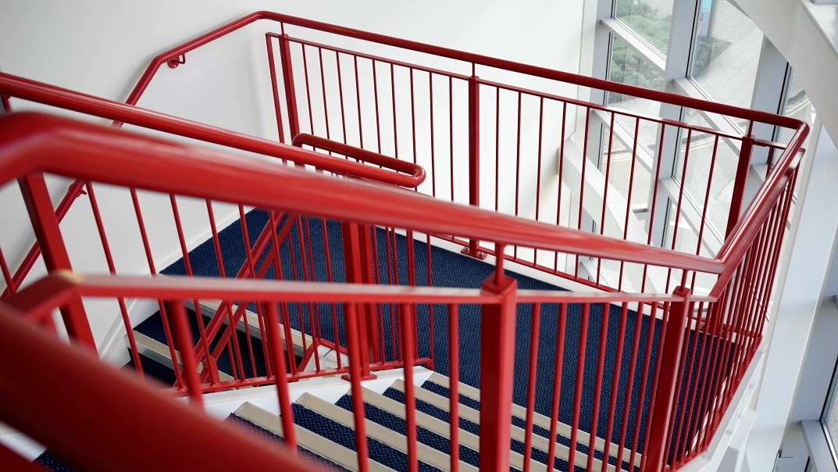
Handrails and Guards
Shape
Location

Slide 65
Outside Stairs
Account for fear of heights
≥ 36 ft
Opaque ≥ 48 in
Separated from interior
Minimize water accumulation
≥ 50 % open on one side

Slide 66
Occupant Loads
Select the appropriate number of people per exit
Determine the capacity of areas with merging flows

Slide 67
Historic Fire
Dusseldorf Airport

Slide 68
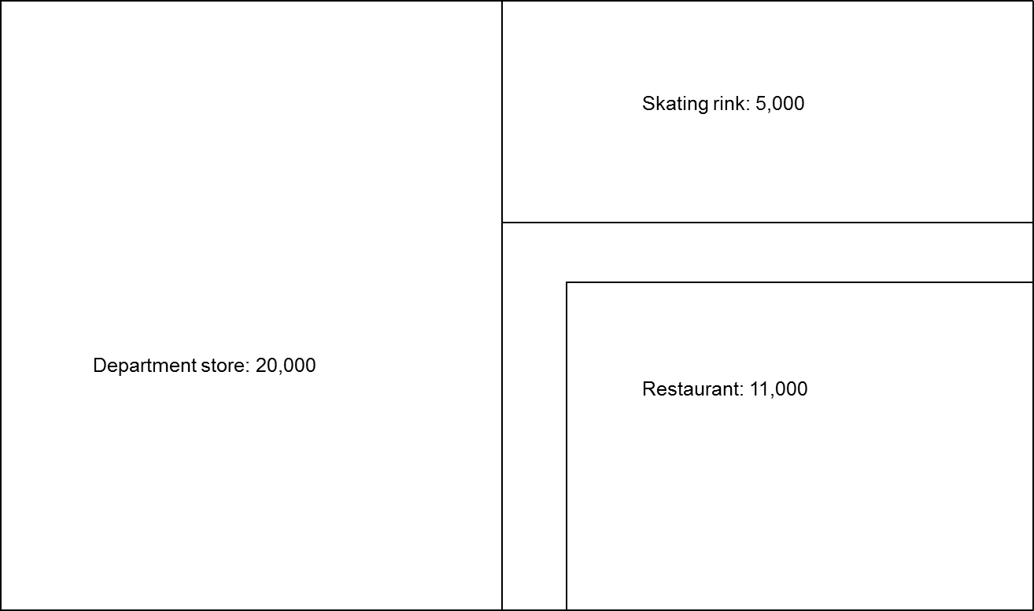
Assigning Exits

Slide 69
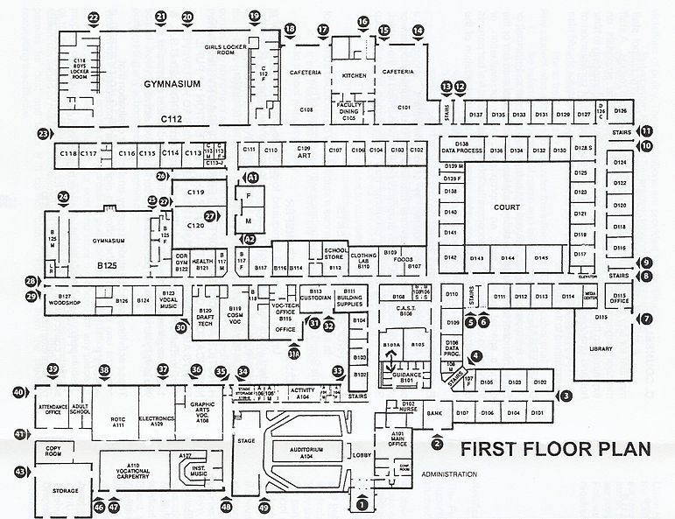
Simultaneous Occupancy

Slide 70
Evacuation Elevators
25 % population + 2 % wheelchairs

Slide 71

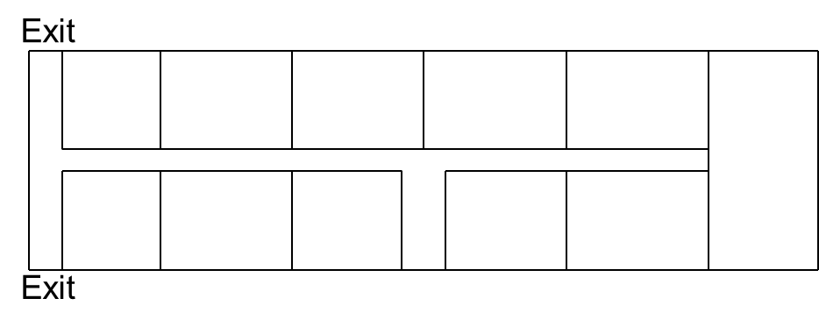
Merging Flows
Corridors
Stairs

Slide 72
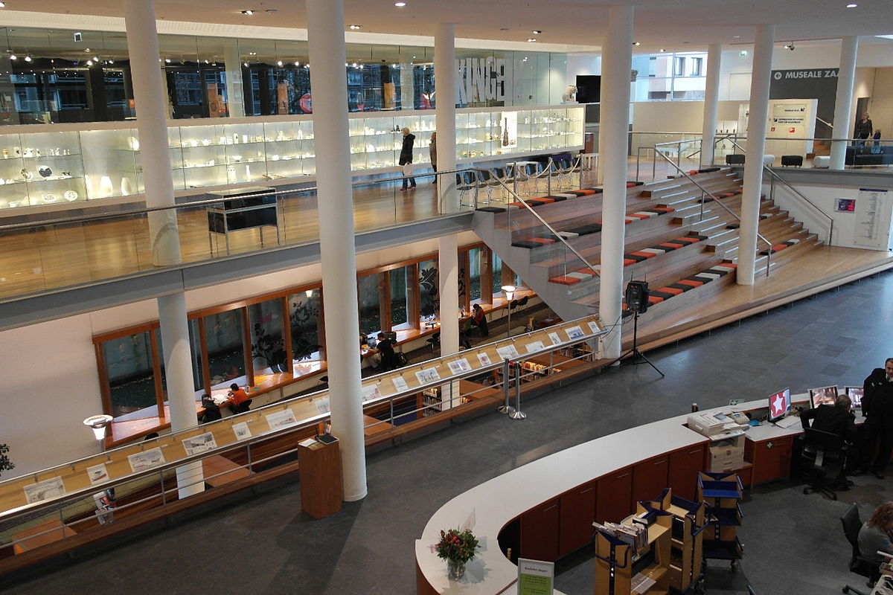
Balconies and Mezzanines

Slide 73
Occupant Loads
Select the appropriate choice between gross and net area
Calculate the occupant load

Slide 74
Historic Fire
Ghost Ship

Slide 75
Occupant Load Factors
Gross
Net
Mixed use

Slide 76
Occupant Load Factors
Minimum design value
Are more people acceptable?
Origin of load factors
Meaning of words
Based on use
Rounding rules

Slide 77
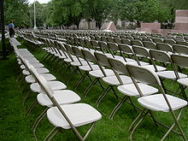

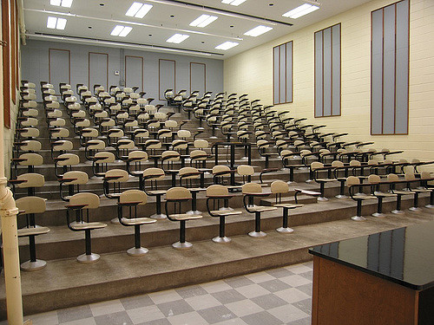
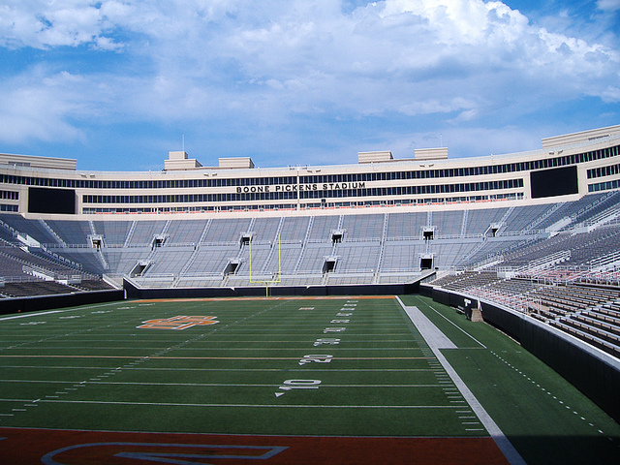

Seating Arrangements
Concentrated
Less concentrated
Fixed
Bench
Waiting spaces

Slide 78
Malls
Load factor varies with size of mall

Slide 79
Exits
Determine the remoteness of exits
Calculate the capacity of exits

Slide 80
Historic Fire
Katie Jane Memorial Home

Slide 81
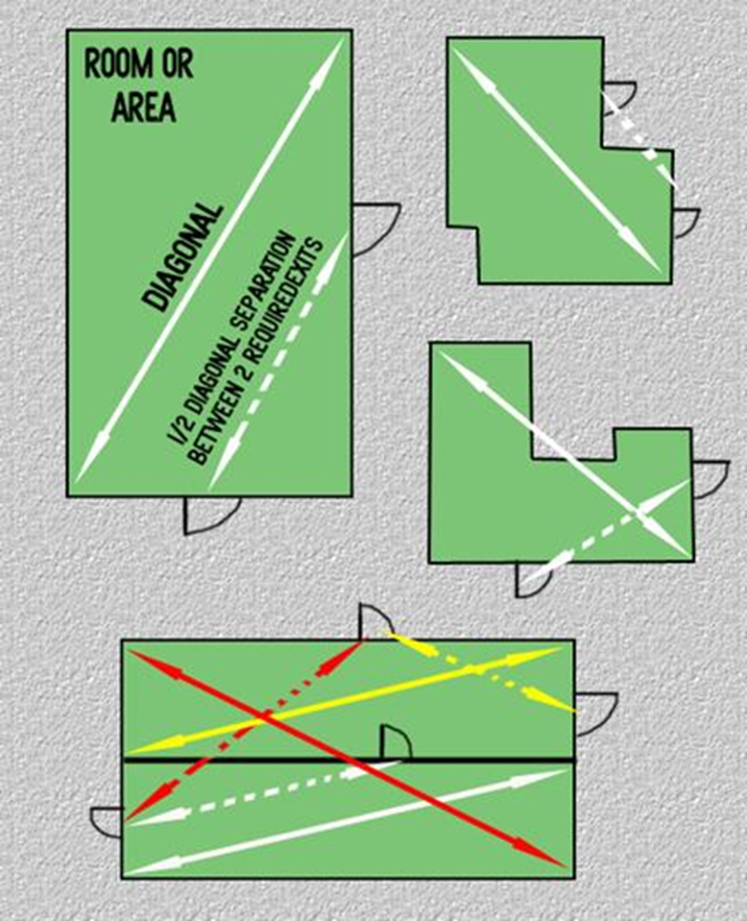
Remote
Rules for two exits
Additional exits as far apart as is practical
Sprinkler trade-off
No familiarity requirements

Slide 82
Requirements
Openings from normally occupied spaces
Rating depends on building height
1 hr for 3 stories or less
2 hr for 4 stories or more

Slide 83
Discharge
Remote
All outside
50 % in some instances
Barrier

Slide 84
Capacity
Typically for existing buildings
Change of use
Reconstruction on floor
Look for limiting component
More to consider than just the first component
Rounding

Slide 85
Distances
Determine where distance calculations are required
Calculate distances
Explain the limits on dead end corridors and common path of travel

Slide 86
Historic Fire
Iroquois Theater

Slide 87

Travel Distance
When to measure
Two paths
EXIT ACCESS
STREET
EXIT DISCHARGE
S
T
R
E
E
T
EXIT
GROUND FLOOR

Slide 88



Rooms
How to measure

Slide 89

Corridors
Natural path
Minimum 12 in clearance around curves/obstructions
To exit
Door

Slide 90
Stairs
On treads
On landing

Slide 91
Areas of Concern
Dead End Corridors
Common Path of Travel

